Slide 1
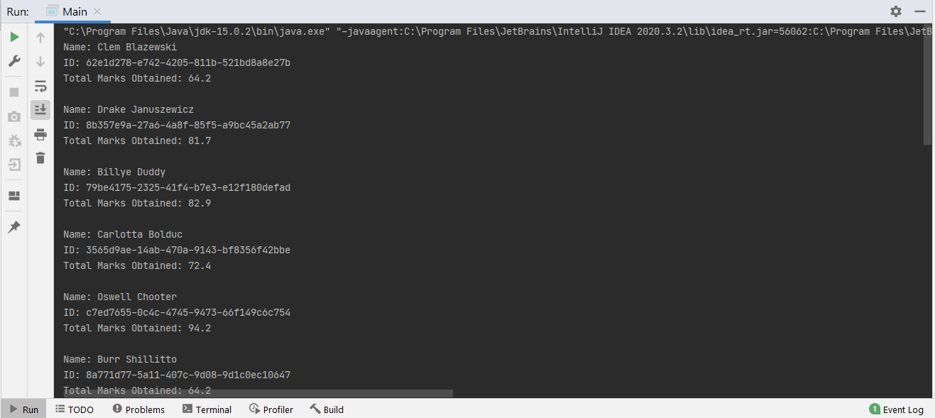
ID-2014310 Pg-1

Slide 2
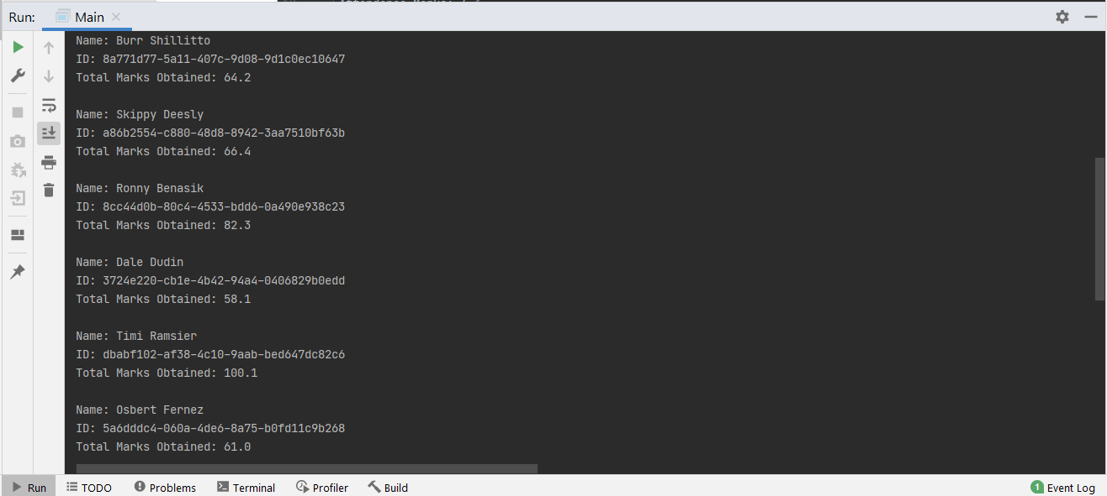
ID-2014310 Pg-2

Slide 3
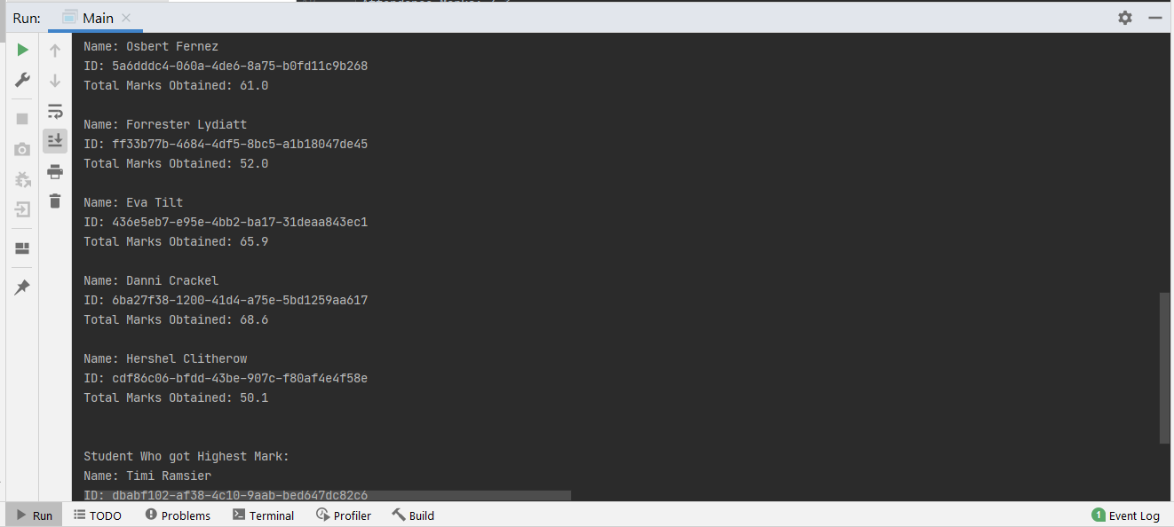
ID-2014310 Pg-3

Slide 4
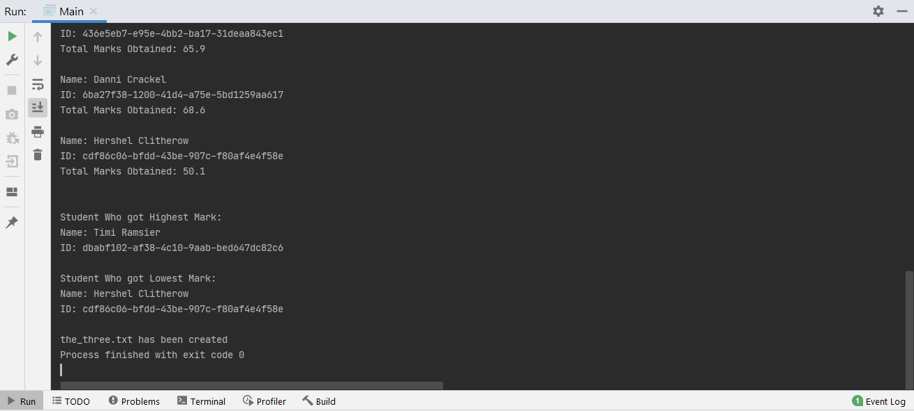
ID-2014310 Pg-4

